Slide 1
CHAPTER 13 descriptive research

Slide 2
An Introduction to Descriptive Research
What is its goal?
  To describe a single variable or to describe each individual when several are involved
Measures a variable or set of variables as they exist naturally
Not concerned with relationships between variables
  Results help capture interesting, naturally occurring behavior

Slide 3
The Observational Research Design
The researcher observes
  Systematically records the behavior of individuals to describe the behavior
Results are used simply to describe the variable being studied

Slide 4
Behavioral Observation
Two measurement problems
  The presence of an observer can disrupt natural behaviors
    Raises the question of demand characteristics and reactivity
  Observations are based, in part, on a subjective judgment
    Raises the question of reliability

Slide 5
Addressing the Measurement Problems
First problem can be addressed by concealing the observer
  Alternatively, participants can be habituated to the observer’s presence
    Requires repeated exposure until the observer’s presence is no longer a novel stimulus
Second problem is addressed by using an inter-rater reliability method

Slide 6
Quantifying Observations
How to quantify behavioral observations?
  Frequency method
    Counting instances of each specific behavior
  Duration method
    Fixed-time observation
  Interval method
    Dividing observation period into a series of intervals and recording behavior during each interval

Slide 7
Types of Observation
Naturalistic observation
  No researcher intervention
Participant observation
  Researcher interacts with participants and becomes one of them
Contrived observation
  Researcher sets up a situation likely to produce the desired behavior in participants

Slide 8
Strengths and Weaknesses of the Observational Research Design
Research Design | Strengths | Weakness
Naturalistic observation | Behavior observed in the real world Useful for nonmanipulated behaviors Actual behaviors observed and recorded | Time-consuming Potential for observer influence Potential for subjective interpretation
Participant observation | When natural observation is impossible Get information not accessible otherwise Participation gives unique perspective | Time-consuming Potential for loss of objectivity Increased chance for observer influence
Contrived observation | Do not have to wait for a behavior to occur | Less natural
Notes:
Table 13.1 A Summary of the Strengths and Weaknesses of the Observational Research Design

Slide 9
Measuring Reliability
Cohen’s Kappa (κ)
  Accounts for chance agreement
  Two raters are classifying items into categories (e.g., yes/no, mild/moderate/severe).

Slide 10
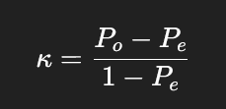
Cohen’s Kappa (1)
P_{o}​ = Observed agreement (the proportion of times the raters agreed)
P_{e} = Expected agreement by chance

Slide 11
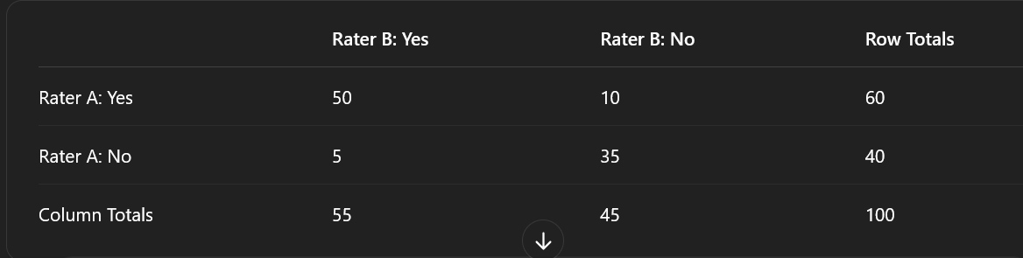
Cohen’s Kappa (2)
100 observations
How many agree?
How may disagree?

Slide 12
Cohen’s Kappa (3)
A
B
C
D
Calculate Observed (P_{o})
Formula: (A + D) / n
P_{o} = ?

Slide 13
Cohen’s Kappa (4)
Calculate Expected (P_{e})
Use the margins!
Multiply Yes: .60 x .55 = .33
Multiple No: .40 x .45 = .18
Add: .33 + .45 = ?

Slide 14
Cohen’s Kappa (5)
κ = (.85 - .51) / (1 - .51)
κ = .694

Slide 15
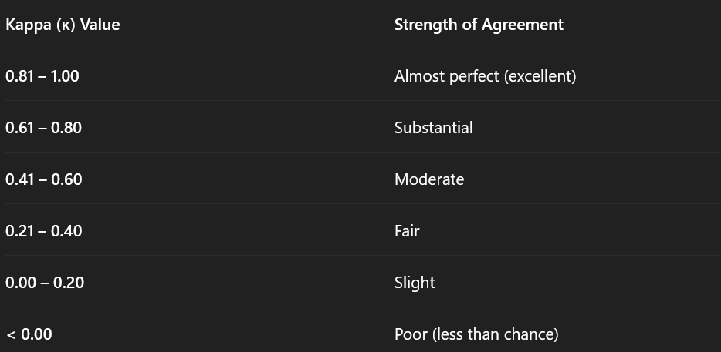
Interpreting Cohen’s κ

Slide 16
More than 2 raters?
Reliability can be improved by increasing number of raters
But Cohen’s kappa is only useful for two raters…
Fleiss’ Kappa: Extension of Cohen’s formula to account for more than 2 raters

